Slide 1

ISE 218: Fundamentals of Information Technology Unit 2: Data Representation
Spring 2025
Instructor: Abid Malik
co-Instructor: Xinrui Yu

Slide 2
Units of Storage
A bit is the most basic unit of information in a computer.
It is a state of “on” or “off” in a digital circuit.
Sometimes these states are “high” or “low” voltage instead of “on” or “off”
A byte is a group of eight bits.
A byte is the smallest possible addressable unit of computer storage.
The term, “addressable,” means that a particular byte can be retrieved according to its location in memory.

Slide 3
Units of Storage
A word is a contiguous group of bytes.
Words can be any number of bits or bytes.
Word sizes of 16, 32, or 64 bits are most common.
In a word-addressable system, a word is the smallest addressable unit of storage.
A group of four bits is called a nibble.
Bytes, therefore, consist of two nibbles: a “high-order nibble,” and a “low-order” nibble.
bits → nibbles → bytes → words

Slide 4
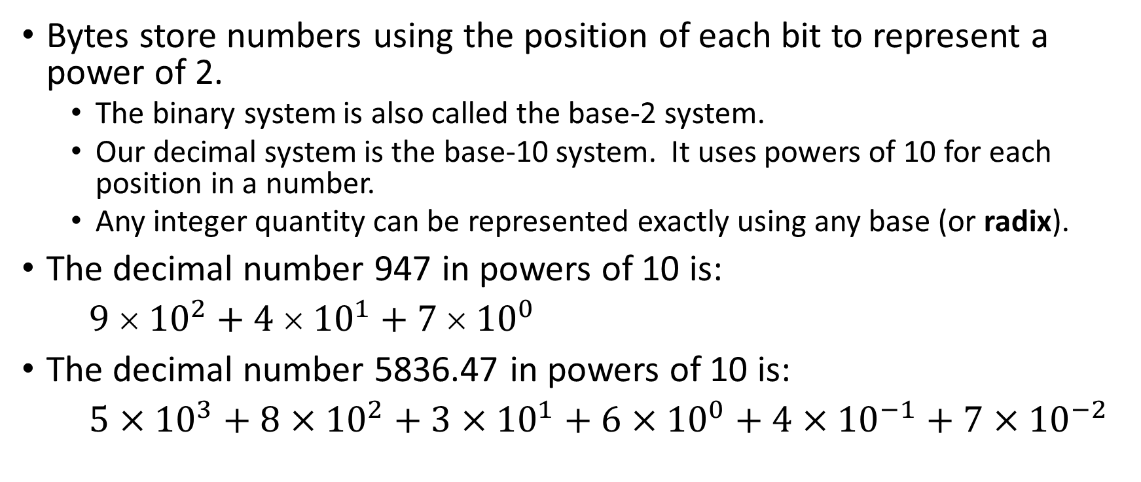
Positional Numbering Systems
Bytes store numbers using the position of each bit to represent a power of 2.
The binary system is also called the base-2 system.
Our decimal system is the base-10 system. It uses powers of 10 for each position in a number.
Any integer quantity can be represented exactly using any base (or radix).
The decimal number 947 in powers of 10 is:
$9  {10}^{2}+4  {10}^{1}+7  {10}^{0}$
The decimal number 5836.47 in powers of 10 is:
$5×{10}^{3}+8×{10}^{2}+3×{10}^{1}+6×{10}^{0}+4×{10}^{−1}+7×{10}^{−2}$

Slide 5
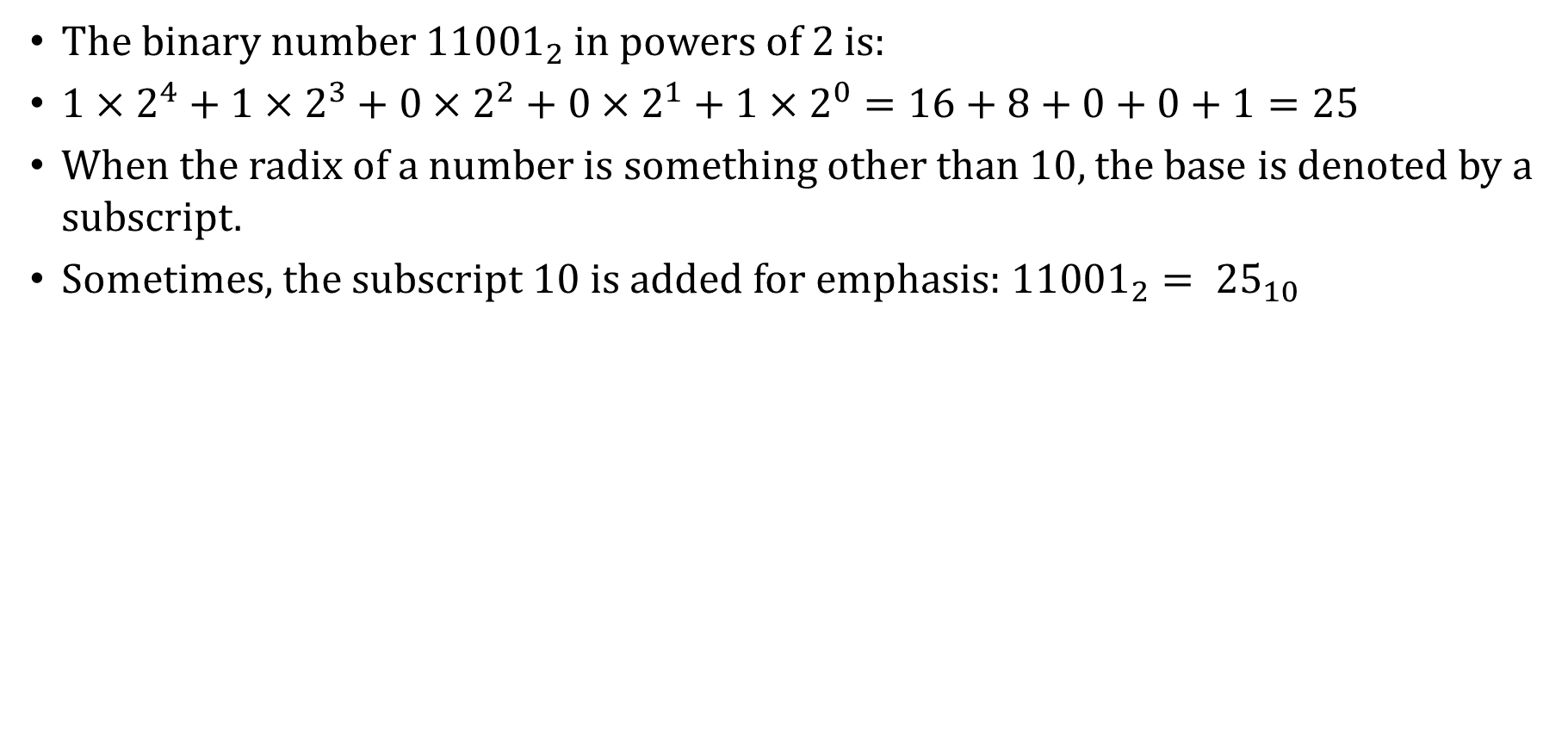
Positional Numbering Systems
The binary number ${11001}_{2}$ in powers of 2 is:
$1×2^{4}+1×2^{3}+0×2^{2}+0×2^{1}+1×2^{0}=16+8+0+0+1=25$
When the radix of a number is something other than 10, the base is denoted by a subscript.
Sometimes, the subscript 10 is added for emphasis: ${11001}_{2}= {25}_{10}$

Slide 6
Converting Between Bases
Because binary numbers are the basis for all data representation in digital computer systems, it is important that you become proficient with this radix system.
Your knowledge of the binary numbering system will enable you to understand the operation of all computer components, as well as the design of instruction set architectures.
Remember that every integer value can be represented exactly using any radix system.
There are two methods for radix conversion: the subtraction method and the division/remainder method.
The subtraction method is perhaps more intuitive, but cumbersome, so we will used the division/remainder method.

Slide 7
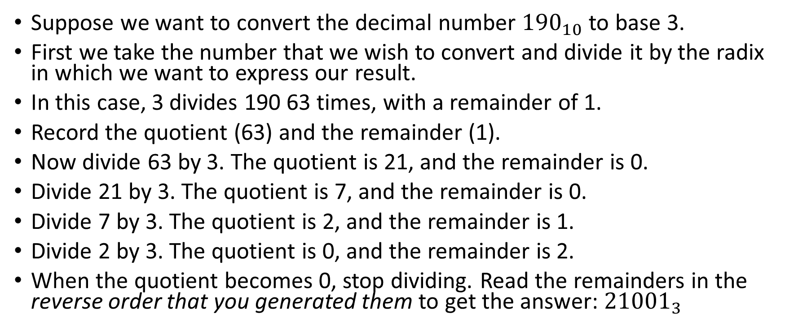
Converting Between Bases: Example #1
Suppose we want to convert the decimal number ${190}_{10}$ to base 3.
First we take the number that we wish to convert and divide it by the radix in which we want to express our result.
In this case, 3 divides 190 63 times, with a remainder of 1.
Record the quotient (63) and the remainder (1).
Now divide 63 by 3. The quotient is 21, and the remainder is 0.
Divide 21 by 3. The quotient is 7, and the remainder is 0.
Divide 7 by 3. The quotient is 2, and the remainder is 1.
Divide 2 by 3. The quotient is 0, and the remainder is 2.
When the quotient becomes 0, stop dividing. Read the remainders in the reverse order that you generated them to get the answer: ${21001}_{3}$

Slide 8
Converting Between Bases: Example #2
Convert 123₁₀ to binary (base 2)
123 / 2 = 61 rem. 1
61 / 2 = 30 rem. 1
30 / 2 = 15 rem. 0
15 / 2 = 7 rem. 1
7 / 2 = 3 rem. 1
3 / 2 = 1 rem. 1
1 / 2 = 0 rem. 1
Answer: 1111011₂

Slide 9
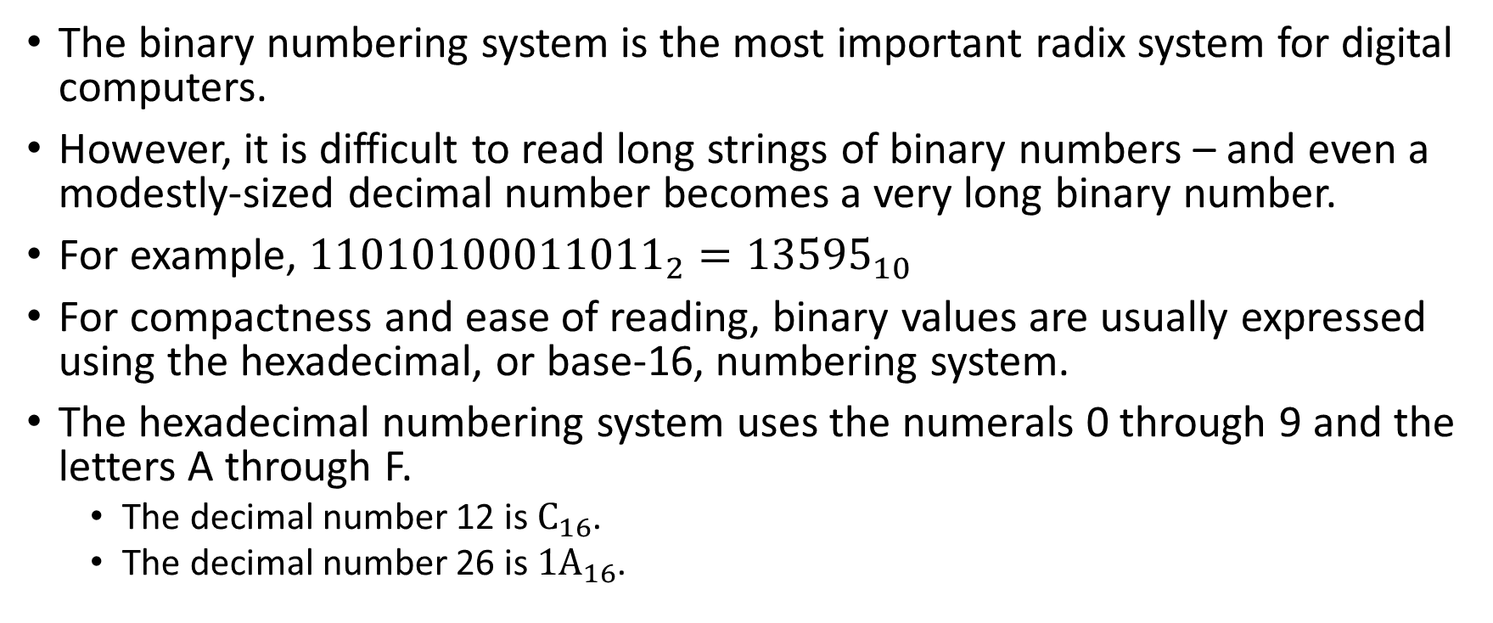
Converting Between Bases
The binary numbering system is the most important radix system for digital computers.
However, it is difficult to read long strings of binary numbers – and even a modestly-sized decimal number becomes a very long binary number.
For example, ${11010100011011}_{2}={13595}_{10}$
For compactness and ease of reading, binary values are usually expressed using the hexadecimal, or base-16, numbering system.
The hexadecimal numbering system uses the numerals 0 through 9 and the letters A through F.
The decimal number 12 is $C_{16}$.
The decimal number 26 is $1A_{16}$.

Slide 10
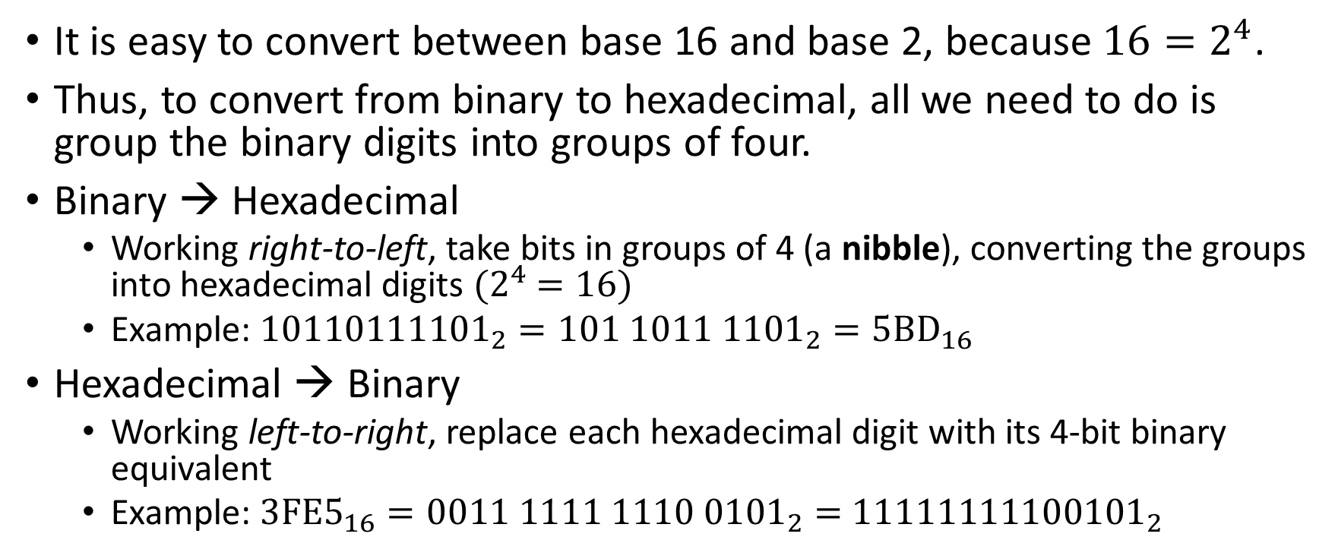
Converting Between Bases
It is easy to convert between base 16 and base 2, because $16=2^{4}$.
Thus, to convert from binary to hexadecimal, all we need to do is group the binary digits into groups of four.
Binary → Hexadecimal
Working right-to-left, take bits in groups of 4 (a nibble), converting the groups into hexadecimal digits ${(2}^{4} =16)$
Example: ${10110111101}_{2}=101 1011 {1101}_{2}={5BD}_{16}$
Hexadecimal → Binary
Working left-to-right, replace each hexadecimal digit with its 4-bit binary equivalent
Example: $3FE5_{16}=0011 1111 1110 {0101}_{2}=$ ${11111111100101}_{2}$

Slide 11
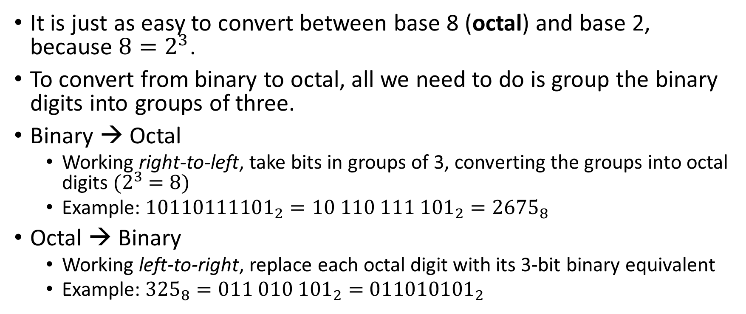
Converting Between Bases
It is just as easy to convert between base 8 (octal) and base 2, because $8=2^{3}$.
To convert from binary to octal, all we need to do is group the binary digits into groups of three.
Binary → Octal
Working right-to-left, take bits in groups of 3, converting the groups into octal digits ${(2}^{3} =8)$
Example: ${10110111101}_{2}=10 110 11{1 101}_{2}={2675}_{8}$
Octal → Binary
Working left-to-right, replace each octal digit with its 3-bit binary equivalent
Example: $325_{8}=011 {010 101}_{2}=$ ${011010101}_{2}$

Slide 12
Converting Between Bases
Base 10 | Base 2 | Base 8 | Base 16
0 | 0000 | 0 | 0
1 | 0001 | 1 | 1
2 | 0010 | 2 | 2
3 | 0011 | 3 | 3
4 | 0100 | 4 | 4
5 | 0101 | 5 | 5
6 | 0110 | 6 | 6
7 | 0111 | 7 | 7
Base 10 | Base 2 | Base 8 | Base 16
8 | 1000 | 10 | 8
9 | 1001 | 11 | 9
10 | 1010 | 12 | A
11 | 1011 | 13 | B
12 | 1100 | 14 | C
13 | 1101 | 15 | D
14 | 1110 | 16 | E
15 | 1111 | 17 | F

Slide 13
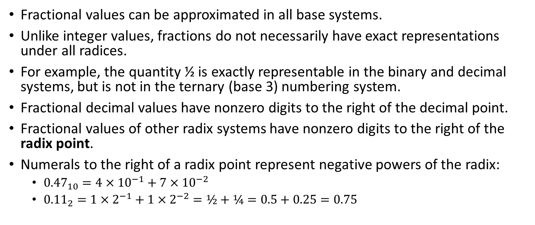
Converting Between Bases
Fractional values can be approximated in all base systems.
Unlike integer values, fractions do not necessarily have exact representations under all radices.
For example, the quantity ½ is exactly representable in the binary and decimal systems, but is not in the ternary (base 3) numbering system.
Fractional decimal values have nonzero digits to the right of the decimal point.
Fractional values of other radix systems have nonzero digits to the right of the radix point.
Numerals to the right of a radix point represent negative powers of the radix:
${0.47}_{10}=4×{10}^{−1}+7×{10}^{−2}$
${0.11}_{2}=1×2^{−1}+1×2^{−2}=½+¼=0.5+0.25=0.75$

Slide 14
Decimal Fractions → Binary
We’ve seen how to convert base-10 integers to binary representation, but what about real numbers?
Let’s see an algorithm for converting fractional decimal values to binary
Generate the bits in left-to-right order, starting from the radix point:
Multiply the decimal value by 2. If the product is greater than or equal to 1, the next bit is 1. Otherwise, the next bit is 0.
Drop the integer part to get a value less than 1.
Continue until 0 is reached (a terminating expansion) or a pattern of digits repeats (a non-terminating expansion).
The resulting representation is called fixed-point format

Slide 15
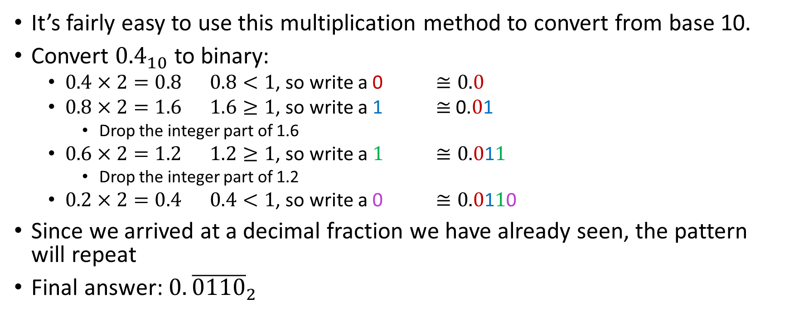
Converting Between Bases: Example #3
It’s fairly easy to use this multiplication method to convert from base 10.
Convert ${0.4}_{10}$ to binary:
$0.4×2=0.8$ $0.8<1$, so write a 0 $≅0.0$
$0.8×2=1.6$ $1.6≥1$, so write a 1 $≅$0.$0$1
Drop the integer part of 1.6
$0.6×2=1.2$ $1.2≥1$, so write a $1$ $≅0.0\text{1}1$
Drop the integer part of 1.2
$0.2×2=0.4$ $0.4<1$, so write a 0 $≅0.0\text{1}1\text{0}$
Since we arrived at a decimal fraction we have already seen, the pattern will repeat
Final answer: $0.{\overline{0110}}_{2}$

Slide 16
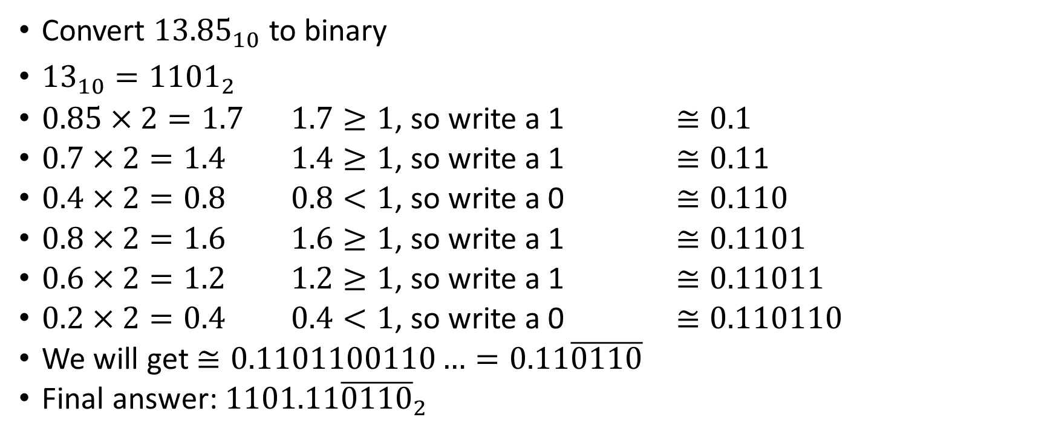
Converting Between Bases: Example #4
Convert ${13.85}_{10}$ to binary
${13}_{10}={1101}_{2}$
$0.85×2=1.7$ $1.7≥1$, so write a 1 $≅0.1$
$0.7×2=1.4$ $1.4≥1$, so write a 1 $≅0.1$1
$0.4×2=0.8$ $0.8<1$, so write a 0 $≅0.110$
$0.8×2=1.6$ $1.6≥1$, so write a 1 $≅0.1101$
$0.6×2=1.2$ $1.2≥1$, so write a 1 $≅0.11011$
$0.2×2=0.4$ $0.4<1$, so write a 0 $≅0.110110$
We will get $≅0.1101100110…=0.11\overline{0110}$
Final answer: $1101.11{\overline{0110}}_{2}$

Slide 17
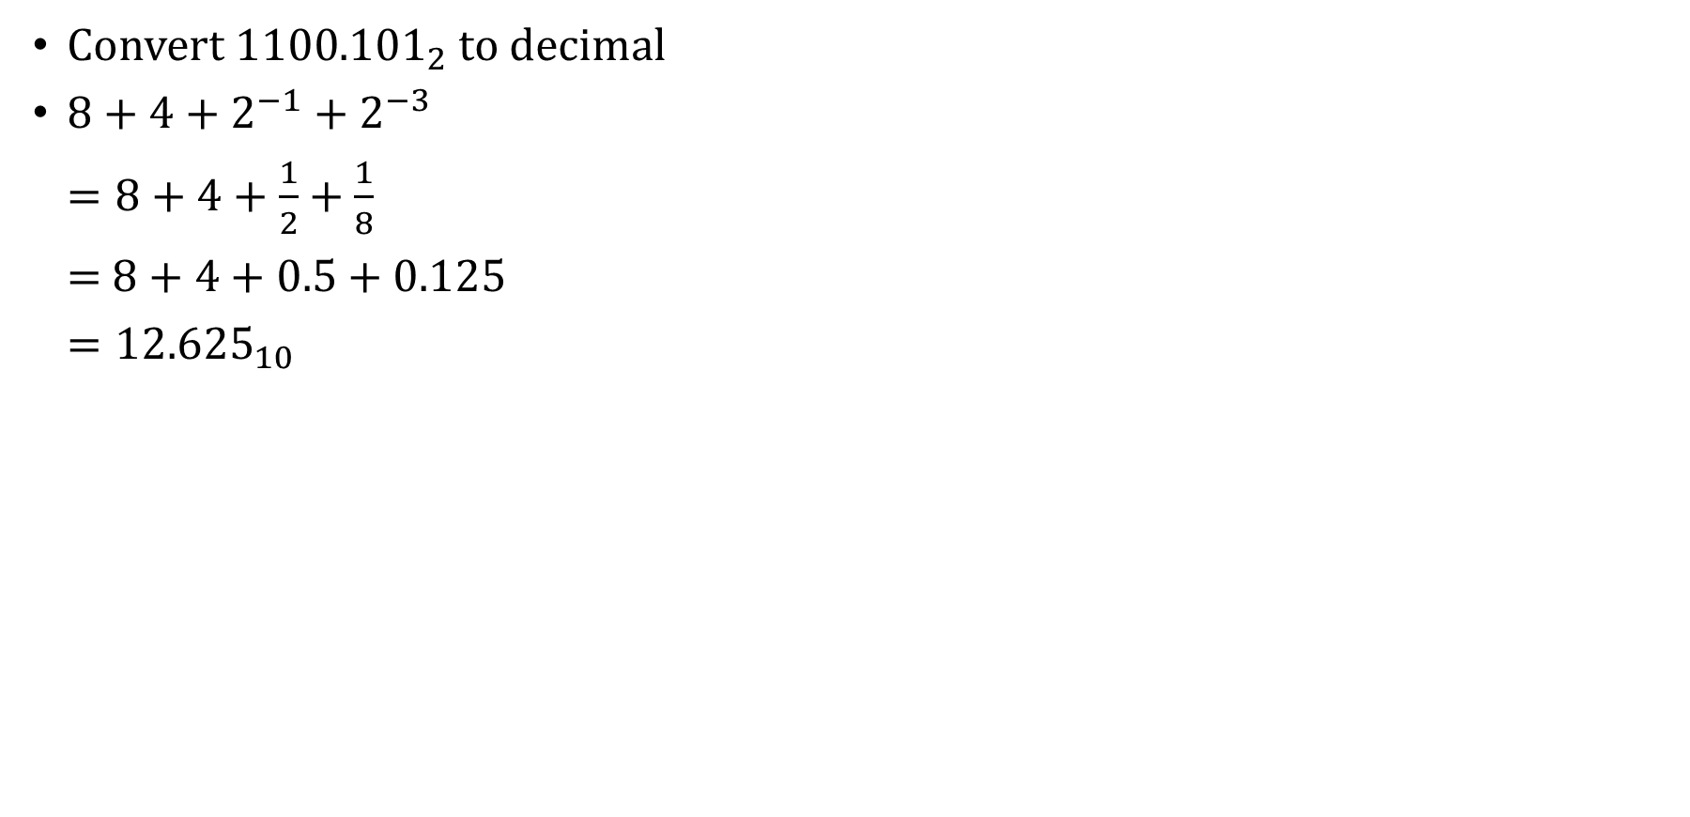
Converting Between Bases: Example #5
Convert ${1100.101}_{2}$ to decimal
$8+4+2^{−1}+2^{−3}$
$=8+4+\frac{1}{2}+\frac{1}{8}$
$=$ $8+4+0.5+0.125$
$={12.625}_{10}$

Slide 18
Signed Integer Representation
The conversions we have so far presented have involved only unsigned numbers (zero and positive numbers).
To represent signed integers, computer systems allocate the leftmost bit to indicate the sign of a number.
The leftmost bit is also called the most significant bit.
0 is used to indicate a positive number; 1 indicates a negative number.
The remaining bits contain the value of the number (but this can be interpreted different ways)
We will look at two ways for expressing signed binary integers: sign/magnitude and two’s complement

Slide 19
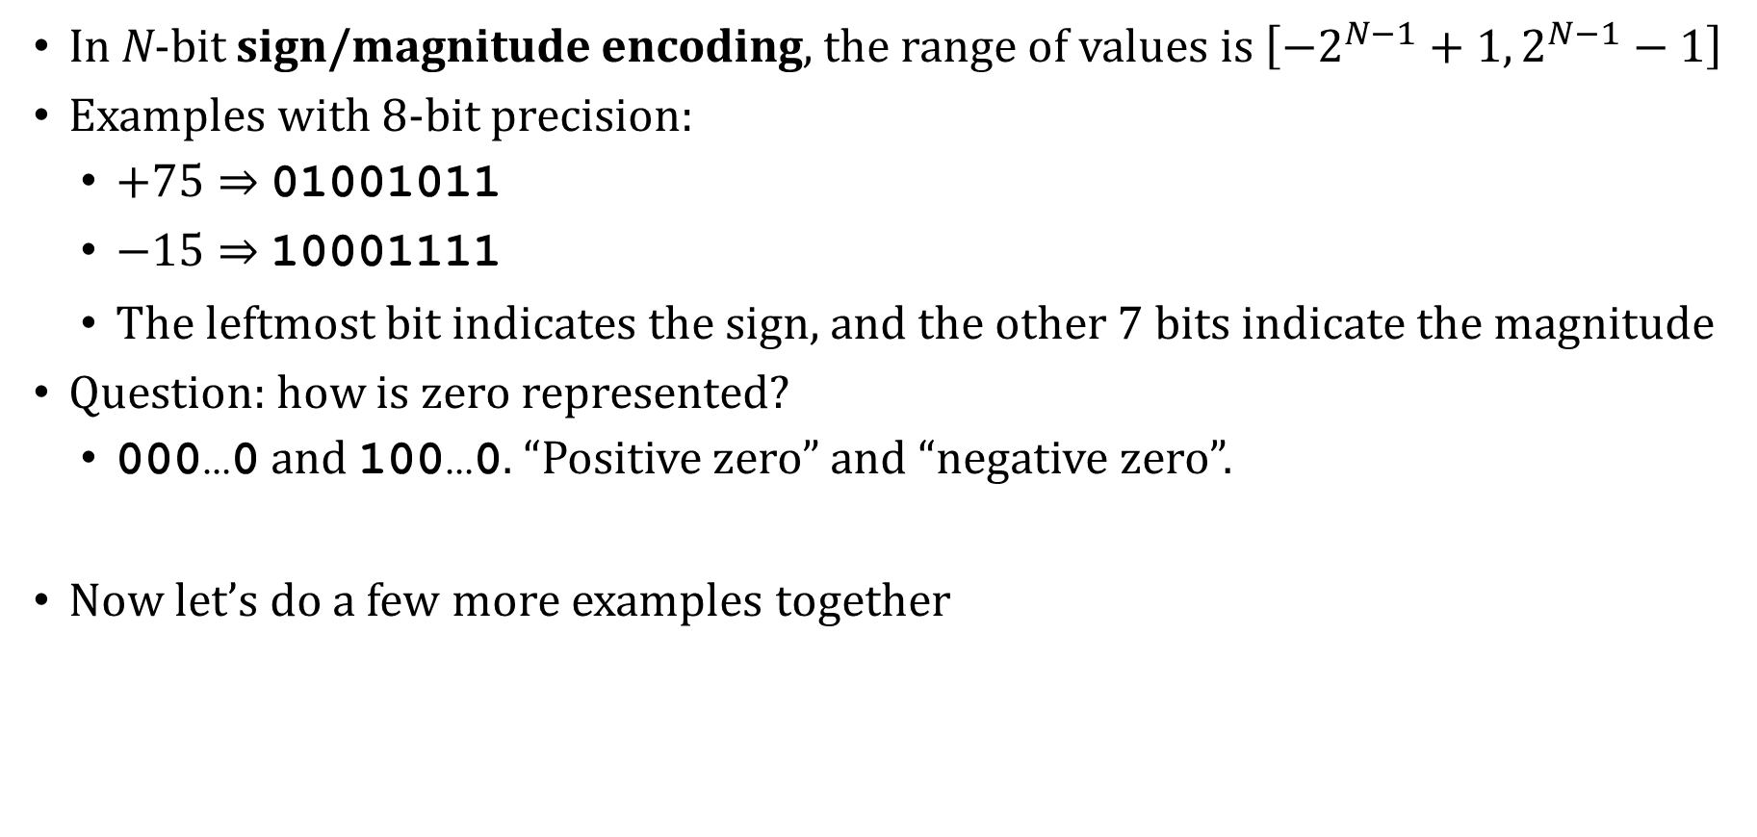
Signed Integer Representation
In N-bit sign/magnitude encoding, the range of values is $\left[−2^{N−1}+{1, 2}^{N−1}−1\right]$
Examples with 8-bit precision:
$+75⇒$ 01001011
$−15⇒$10001111
The leftmost bit indicates the sign, and the other 7 bits indicate the magnitude
Question: how is zero represented?
000…0 and 100…0. “Positive zero” and “negative zero”.
Now let’s do a few more examples together

Slide 20
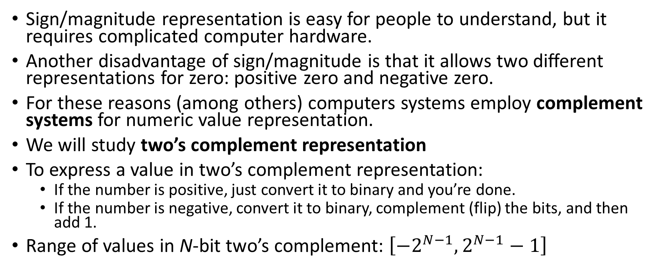
Signed Integer Representation
Sign/magnitude representation is easy for people to understand, but it requires complicated computer hardware.
Another disadvantage of sign/magnitude is that it allows two different representations for zero: positive zero and negative zero.
For these reasons (among others) computers systems employ complement systems for numeric value representation.
We will study two’s complement representation
To express a value in two’s complement representation:
If the number is positive, just convert it to binary and you’re done.
If the number is negative, convert it to binary, complement (flip) the bits, and then add 1.
Range of values in N-bit two’s complement: $\left[−2^{N−1},2^{N−1}−1\right]$

Slide 21
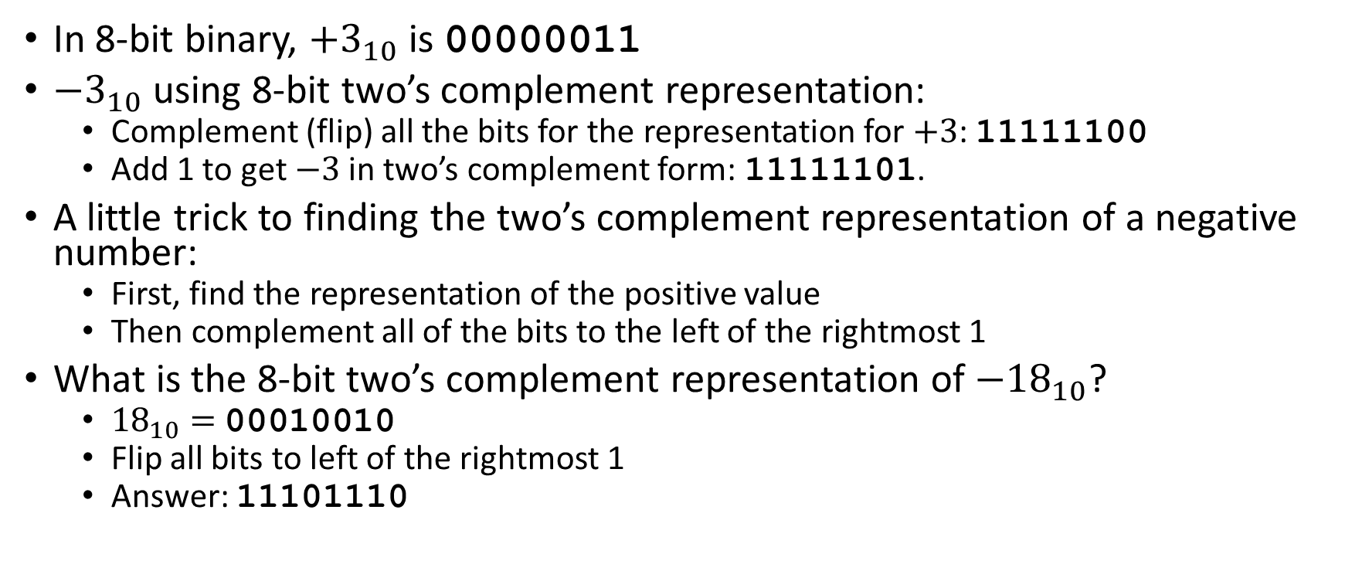
Signed Integer Representation: Examples
In 8-bit binary, $+3_{10}$ is 00000011
$−3_{10}$ using 8-bit two’s complement representation:
Complement (flip) all the bits for the representation for $+3$: 11111100
Add 1 to get $−3$ in two’s complement form: 11111101.
A little trick to finding the two’s complement representation of a negative number:
First, find the representation of the positive value
Then complement all of the bits to the left of the rightmost 1
What is the 8-bit two’s complement representation of $−{18}_{10}$?
${18}_{10}=$00010010
Flip all bits to left of the rightmost 1
Answer: 11101110

Slide 22
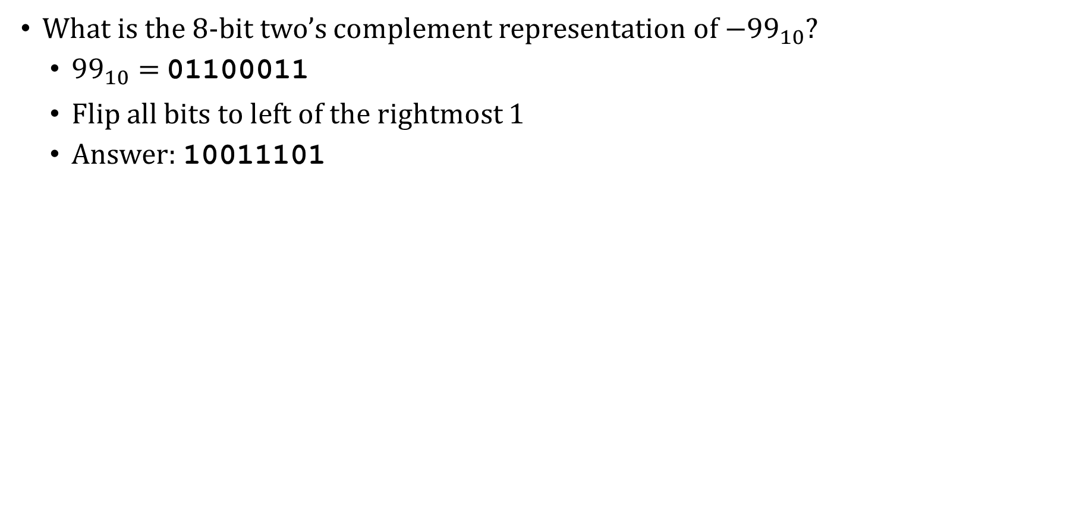
Signed Integer Representation: Examples
What is the 8-bit two’s complement representation of $−{99}_{10}$?
${99}_{10}=$01100011
Flip all bits to left of the rightmost 1
Answer: 10011101

Slide 23
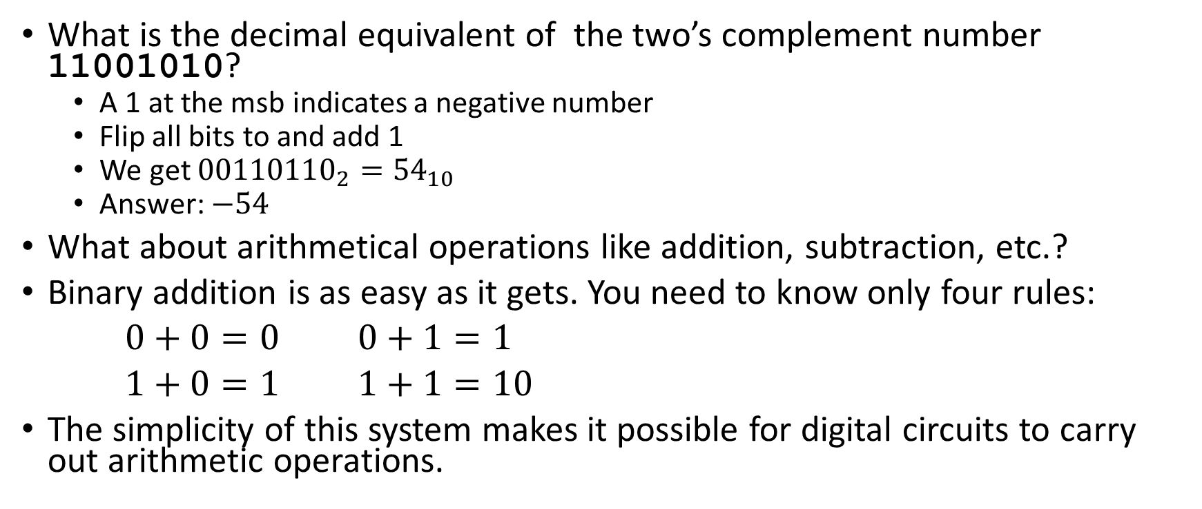
Signed Integer Representation: Examples
What is the decimal equivalent of the two’s complement number 11001010?
A 1 at the msb indicates a negative number
Flip all bits to and add 1
We get ${00110110}_{2}={54}_{10}$
Answer: $−54$
What about arithmetical operations like addition, subtraction, etc.?
Binary addition is as easy as it gets. You need to know only four rules:
$0+0=0$ $0+1=1$
$1+0=1$ $1+1=10$
The simplicity of this system makes it possible for digital circuits to carry out arithmetic operations.

Slide 24
Binary Arithmetic: Example #1
Binary arithmetic with positive integers (particularly, addition), is done in the usual way
With decimal addition we can have carried values:
Carry values: 11
74₁₀
+89₁₀
Sum: 163₁₀
The same thing can happen with binary addition (below: unsigned numbers):
Carry values: 1 1 1
0 1 0 0 1 0 1 0₂
+ 0 1 0 1 1 0 0 1₂
Sum: 1 0 1 0 0 0 1 1₂

Slide 25
Binary Arithmetic: Example #2
Now add the following two 8-bit, unsigned binary numbers:
1 1 1 1 1 1 1 1 0 1 0 1 1 1₂
+ 0 1 0 1 0 0 0 1₂
1 0 0 1 0 1 0 0 0₂
We had an overflow.
In fixed-precision integer arithmetic, it is possible for an arithmetic operation, such as addition, to result in an overflow. The leftmost carry value is dropped, resulting in an incorrect sum.
Computer programmers must be aware of the range of representable values to avoid overflow

Slide 26
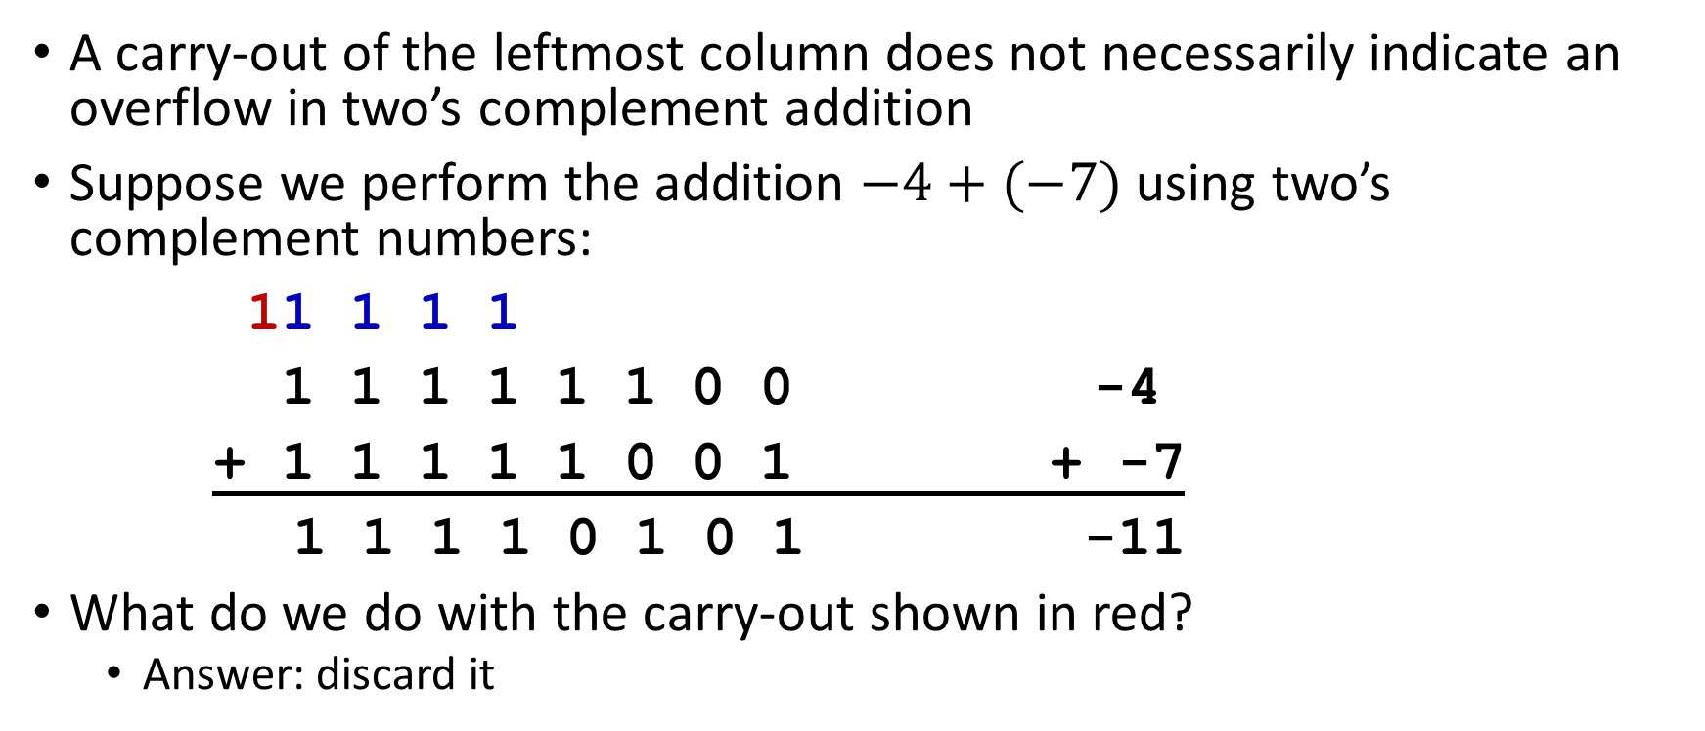
Binary Arithmetic: Example #3
A carry-out of the leftmost column does not necessarily indicate an overflow in two’s complement addition
Suppose we perform the addition $−4+(−7)$ using two’s complement numbers:
11 1 1 1
1 1 1 1 1 1 0 0 -4
+ 1 1 1 1 1 0 0 1 + -7
1 1 1 1 0 1 0 1 -11
What do we do with the carry-out shown in red?
Answer: discard it

Slide 27

Binary Arithmetic: Example #4
Add $23$ and $−9$ using two’s complement numbers:
1 1 1 1 1 1 1
0 0 0 1 0 1 1 1 23
+ 1 1 1 1 0 1 1 1 + -9
0 0 0 0 1 1 1 0 14

Slide 28
Binary Arithmetic: Example #5
In signed arithmetic using two’s complement encoding, there is a possibility of overflow when the correct result is “too large” or “too small” to be represented.
Overflow cannot occur when adding numbers of opposite sign.
Overflow can occur when adding numbers of the same sign (or subtracting numbers of opposite sign).
0 1 1 1 1 1 1 0 126
+ 0 0 0 0 0 0 1 1 + 3
1 0 0 0 0 0 0 1 -127
The overflow can be detected by noticing that the sum has opposite sign from the addends.

Slide 29
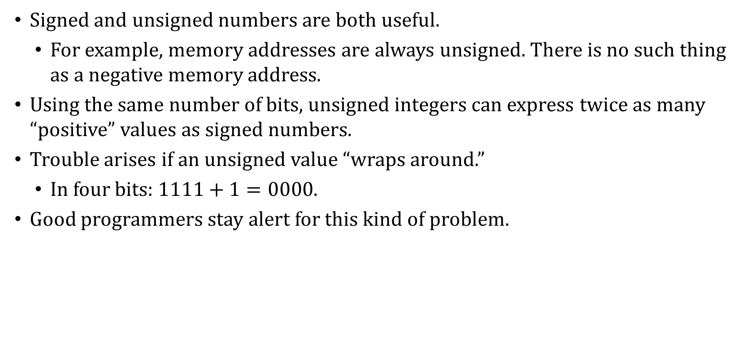
Signed Integer Representations
Signed and unsigned numbers are both useful.
For example, memory addresses are always unsigned. There is no such thing as a negative memory address.
Using the same number of bits, unsigned integers can express twice as many “positive” values as signed numbers.
Trouble arises if an unsigned value “wraps around.”
In four bits: $1111+1=0000$.
Good programmers stay alert for this kind of problem.

Slide 30
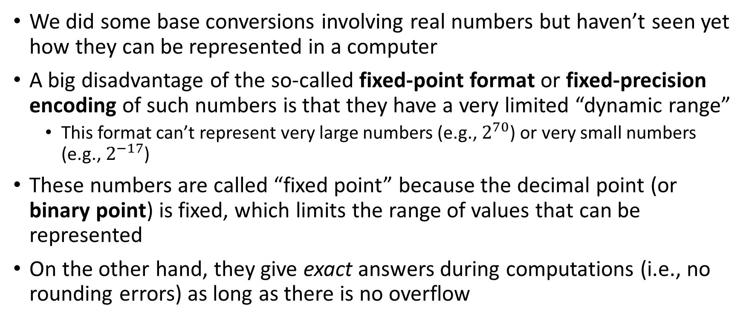
Representing Real Numbers
We did some base conversions involving real numbers but haven’t seen yet how they can be represented in a computer
A big disadvantage of the so-called fixed-point format or fixed-precision encoding of such numbers is that they have a very limited “dynamic range”
This format can’t represent very large numbers (e.g., $2^{70}$) or very small numbers (e.g., $2^{−17}$)
These numbers are called “fixed point” because the decimal point (or binary point) is fixed, which limits the range of values that can be represented
On the other hand, they give exact answers during computations (i.e., no rounding errors) as long as there is no overflow

Slide 31
Floating-Point Format
Because fractions can have non-terminating representations and/or might require many digits to be represented exactly, usually real numbers can only be approximately represented in a computer
We have to tolerate a certain amount of representational error
The industry standard way used to approximate real numbers is called floating-point format
IEEE 754 floating-point standard
In this scheme the binary point is allowed to “float” (i.e., be repositioned) in order to give as accurate an approximation as possible

Slide 32
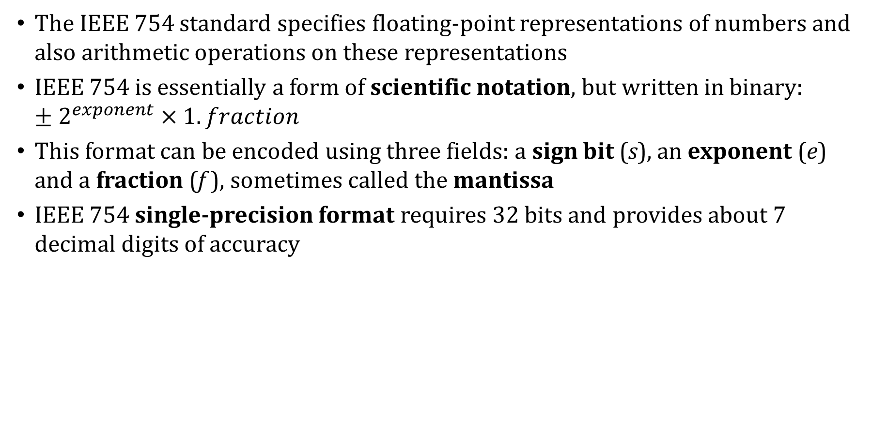
IEEE 754 Floating-Point Standard
The IEEE 754 standard specifies floating-point representations of numbers and also arithmetic operations on these representations
IEEE 754 is essentially a form of scientific notation, but written in binary: $±2^{exponent}×1.fraction$
This format can be encoded using three fields: a sign bit (s), an exponent (e) and a fraction (f ), sometimes called the mantissa
IEEE 754 single-precision format requires 32 bits and provides about 7 decimal digits of accuracy

Slide 33
IEEE 754 Floating-Point Standard
1 bit | 8 bits | 23 bits
sign | exponent | fraction (mantissa)
Sign bit: 0 (positive) or 1 (negative)
Exponent: stored in excess-127 for the 32-bit version
This means that instead of storing the exponent directly in the exponent field, we first add 127 to the exponent before storing it. More on this in a moment.
Fraction: contains the digits to the right of the binary point
Normalized: the digit to the left of the point is always 1, and is not represented, giving us one bit of precision “for free”

Slide 34
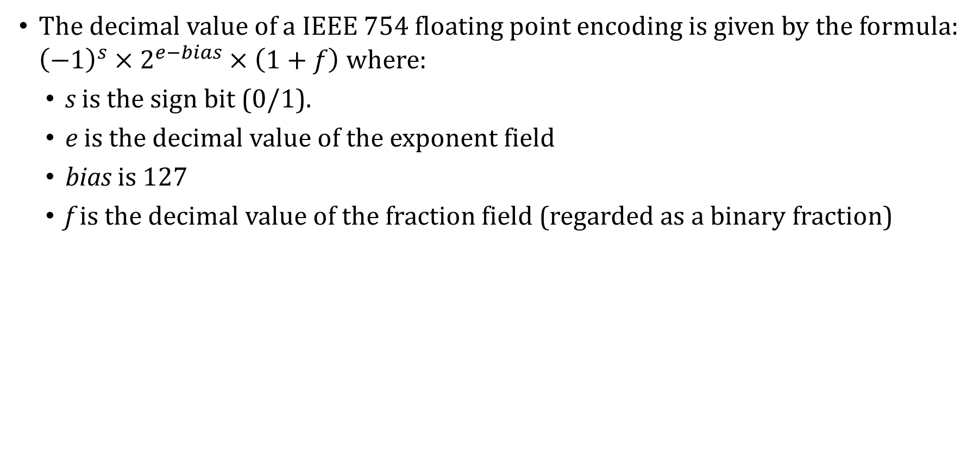
IEEE 754 → Decimal Conversion
The decimal value of a IEEE 754 floating point encoding is given by the formula: ${\left(−1\right)}^{s}×2^{e−bias}×\left(1+f\right)$ where:
s is the sign bit (0/1).
e is the decimal value of the exponent field
bias is 127
f is the decimal value of the fraction field (regarded as a binary fraction)

Slide 35
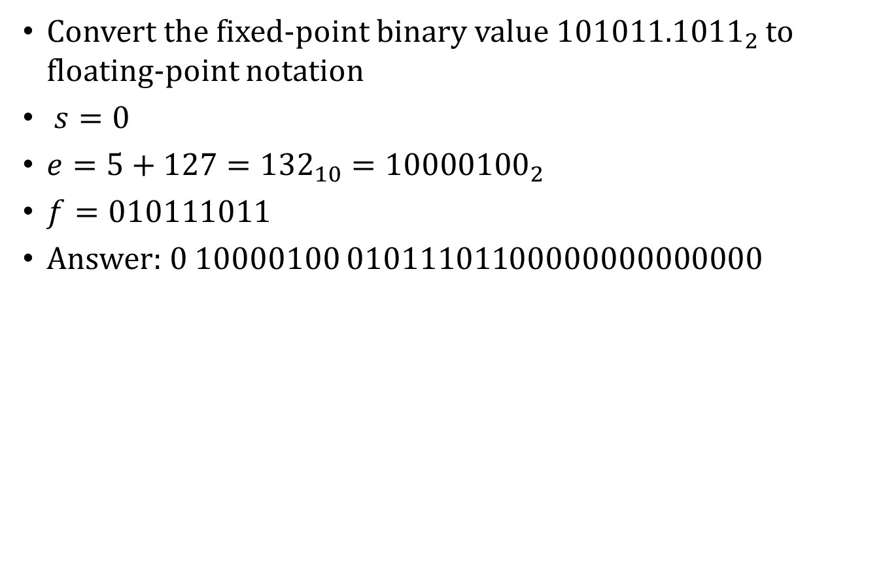
Fixed-point → Floating-point: Example
Convert the fixed-point binary value ${101011.1011}_{2}$ to floating-point notation
$s=0$
$e=5+127={132}_{10}={10000100}_{2}$
$f=010111011$
Answer: 0 10000100 $010111011$00000000000000

Slide 36
IEEE 754 Format → Decimal: Example
What decimal value has the following IEEE 754 encoding? 10111110011000000000000000000000
1 01111100 11000000000000000000000
$s=1$
$e=\left(64+32+16+8+4\right)− 127 =−3$
$f=0.5+0.25=0.75$
Answer: $−1.75×2^{−3}=−{0.21875}_{10}$

Slide 37
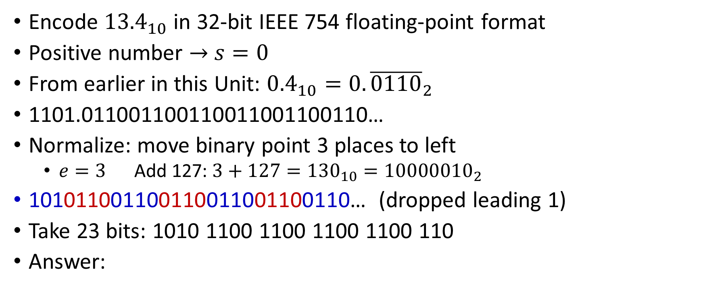
Decimal → IEEE 754 Format: Example
Encode ${13.4}_{10}$ in 32-bit IEEE 754 floating-point format
Positive number → $s=0$
From earlier in this Unit: ${0.4}_{10}=0.{\overline{0110}}_{2}$
1101.011001100110011001100110…
Normalize: move binary point 3 places to left
$e=3$ Add 127: $3+127={130}_{10}={10000010}_{2}$
101011001100110011001100110… (dropped leading 1)
Take 23 bits: 1010 1100 1100 1100 1100 110
Answer:
s | e | f
0 | 10000010 | 10101100110011001100110

Slide 38
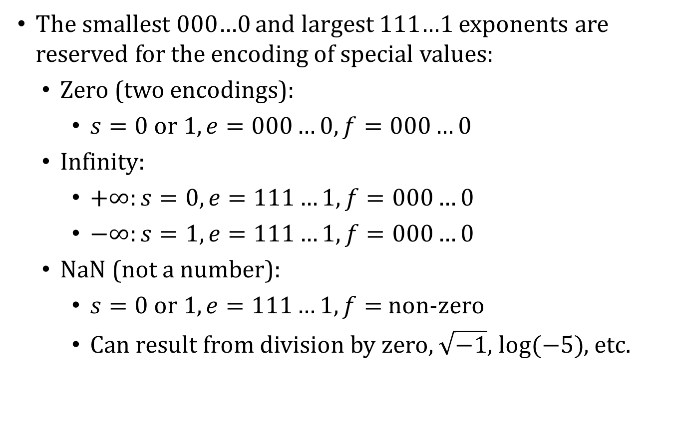
IEEE 754 Special Values
The smallest 000…0 and largest 111…1 exponents are reserved for the encoding of special values:
Zero (two encodings):
$s=0 or 1, e=000…0, f=000…0$
Infinity:
$+∞:s=0, e=111…1, f=000…0$
$−∞:s=1, e=111…1, f=000…0$
NaN (not a number):
$s=0 or 1, e=111…1, f=$ non-zero
Can result from division by zero, $\sqrt{−1}$, $log⁡(−5)$, etc.

Slide 39
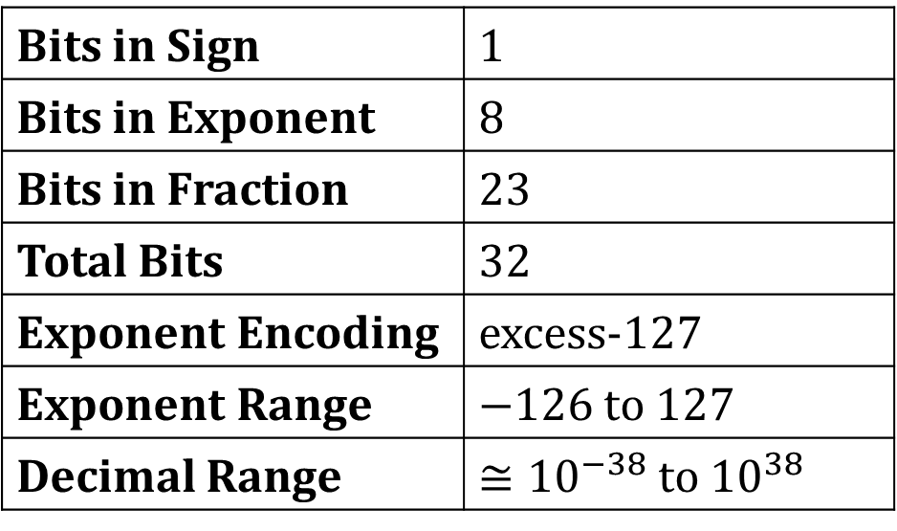
IEEE 754 Format Summary
Bits in Sign | 1
Bits in Exponent | 8
Bits in Fraction | 23
Total Bits | 32
Exponent Encoding | excess-127
Exponent Range | $−126$ to 127
Decimal Range | $≅{10}^{−38}$ to ${10}^{38}$

Slide 40
Character Codes
Calculations aren’t useful until their results can be displayed in a manner that is meaningful to people.
We also need to store the results of calculations, and provide a means for data input.
Thus, human-understandable characters must be converted to computer-understandable bit patterns using some sort of character encoding scheme.
As computers have evolved, character codes have evolved.
Larger computer memories and storage devices permit richer character codes.
The earliest computer coding systems used six bits.
Binary-coded decimal (BCD) was one of these early codes. It was used by IBM mainframes in the 1950s and 1960s.

Slide 41
Character Codes
Other computer manufacturers chose the 7-bit ASCII (American Standard Code for Information Interchange) as a replacement for 6-bit codes.
Until recently, ASCII was the dominant character code outside the IBM mainframe world.
IBM mainframes still use EBCDIC (Extended Binary Coded Decimal Interchange Code)
Many of today’s systems embrace Unicode, a 16-bit system that can encode the characters of every language in the world.
The Java programming language, and some operating systems now use Unicode as their default character code.
The Unicode codespace is divided into six parts. The first part is for Western alphabet codes, including English, Greek, and Russian.

Slide 42
Character Codes
The Unicode codespace allocation is shown at the right.
The lowest-numbered Unicode characters comprise the ASCII code.
The highest provide for user-defined codes.
unicode-table.com/en
Character Types | Language | Number of Characters | Hexadecimal Values
Alphabets | Latin, Greek, Cyrillic, etc. | 8192 | 0000 – 1FFF
Symbols | Dingbats, Mathematical, etc. | 4096 | 2000 – 2FFF
CJK | Chinese, Japanese and Korean symbols | 4096 | 3000 – 3FFF
Han | Unified Chinese, Japanese and Korean | 40,960 | 4000 – DFFF
 | Han Expansion | 4096 | E000 – EFFF
User-defined |  | 4095 | F000 – FFFE

